Slide 1
SECD2613
System Analysis and Design
TOPIC I
Fundamentals of Systems Analysis & Design
update: August 2019 (sharinhh)

Slide 2
PART 1
Organization impact on Information System
Types of Information Systems

Slide 3
OBJECTIVES
By the end of this lecture, you will be able to:
Recall the basic types of computer-based systems that a systems analyst needs to address
Understand how users working in context with new technologies change the dynamics of a system
Realize what the many roles of the systems analyst are
Know the steps of the SDLC as they relate to HCI and how to apply them to a real system
Understand what CASE tools are and how they help a systems analyst
Explore other methodologies such as object-oriented systems design and prototyping

Slide 4
INFORMATION – A KEY RESOURCE
Fuels business and can be the critical factor in determining the success or failure of a business
Needs to be managed correctly
Managing computer-generated information differs from handling manually produced data
Notes:
Information is now considered a key resource and must be managed the same as any other key resource of an organization.
Decision makers now understand that information is not just a byproduct of doing business
Needs to be managed correctly. Costs are associated with the production, distribution, security, storage, and retrieval of all information. Its strategic use for positioning a business competitively should not be taken for granted.
With the availability of networked computers, along with access to the Internet and the WWW we are in the midst of an information explosion. The managing of computer-generated information rises issues with greater cost associated with organizing and maintaining and having users treat it less skeptically than information obtained in different ways.

Slide 5
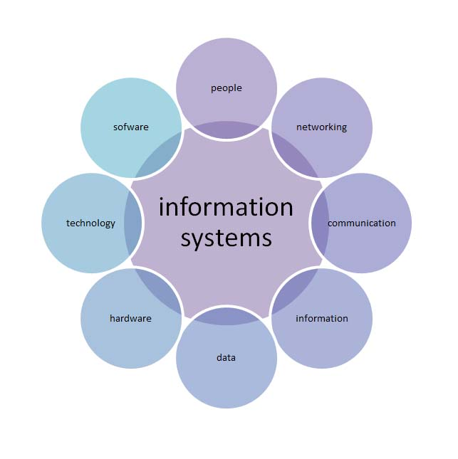
WHAT IS INFORMATION SYSTEMS (IS)?
A system which assembles, stores,
processes and delivers information relevant to an organization, in such a way that the information is accessible and useful to those who wish to use it, including managers, staff, clients and citizens.
An IS is human activity (social system) which may or may not involve the use of computer systems
…Buckingham et al. (1987)

Slide 6







WHAT & WHY SYSTEM ANALYSIS AND DESIGN (SAD)?
Systems analysis and design is a systematic approach to identifying problems, opportunities, and objectives; analyzing the information flows in organizations; and designing computerized (in this case) information systems to solve a problem
(Computerized)
Information
Systems

Slide 7
WHAT & WHY SYSTEM ANALYSIS AND DESIGN (SAD)?
System development needs proper planning.
There is a cost in system development.
It is time consuming and needs project management.
SAD is about problem solving that needs to be creative, critical, and innovative.

Slide 8
ORGANIZATION AS SYSTEMS
Organization as systems, is composed of subsystems and so on.
It is mainly involves levels of management and culture.
These will impact the information system development.
The different levels of management will produce the different levels of decisions.
The culture influences the way people in subsystems interrelate.

Slide 9
ORGANIZATION AS SYSTEMS
Goals
OUTPUT/INPUT
STUDENT AFFAIR
FACULTY
OUTPUT/INPUT

Slide 10
6 Generic
Components
SYSTEM
Processing
Control
Boundary
Output
Input
Feedback
Data
People
Data
People
6 Generic
Components
6 Generic
Components
+
Hardware
+
Software
Procedures
Procedures
Information Systems
Automated Information Systems

Slide 11



ORGANIZATION AS SYSTEMS
Level of Management
What ?
Strategic
Mgt
Tactical Mgt
How ?
Operations Mgt
Implement ?

Slide 12
System: a collection of interrelated components that function together to achieve some outcome
PRODUCTION SYSTEM (SUPER-SYSTEM)
Inventory
management
system
Information System: a collection of interrelated components that collect, process, store, and provide as output the information needed to complete business tasks.
Manufacturing
System
Customer
support
system
Customer
maintenance
subsystem
Order-entry
subsystem
Sub-system: a system that is part of a larger system
Catalog
maintenance
subsystem
Order
fulfillment
subsystem
Super-system: a larger system that contains other systems

Slide 13
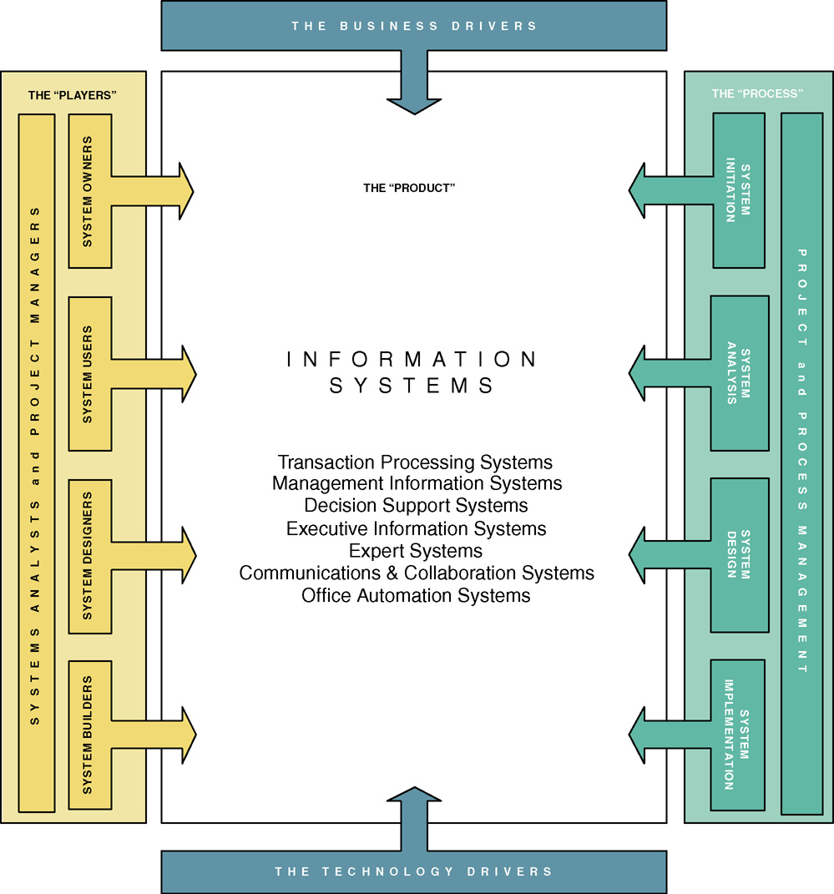
A FRAMEWORK FOR IS

Slide 14
BUSINESS DRIVERS FOR TODAY’S INFORMATION SYSTEMS
Globalization of the Economy
Electronic Commerce and Business
Security and Privacy
Collaboration and Partnership
Knowledge Asset Management
Continuous Improvement and Total Quality Management
Business Process Redesign

Slide 15
BUSINESS DRIVERS FOR TODAY’S INFORMATION SYSTEMS
Networks and the Internet
Mobile and Wireless Technologies
Object Technologies
Collaborative Technologies
Enterprise Applications

Slide 16
Fundamentals of different kinds of information systems
Roles of systems analysts
Phases in the systems development life cycle as they relate to Human-Computer Interaction (HCI) factors
Computer-Aided Software Engineering (CASE) tools
MAJOR TOPICS

Slide 17
TYPES OF SYSTEMS
  Systems analysts recommend, design, and maintain many types of systems for users:
  Transaction Processing Systems (TPS)
  Office Automation Systems (OAS)
  Knowledge Work Systems (KWS)
  Management Information Systems (MIS)
  Decision Support Systems (DSS)
  Expert Systems (ES)
  Executive Support Systems (ESS)
  Group Decision Support Systems (GDSS)
  Computer-Supported Collaborative Work Systems (CSCWS)
Notes:
Information systems are developed for different purposes, depending on the needs of the business.
Operational
TPS
Knowledge Level
OAS
KWS
Higher Level
MIS
DSS
ES
Strategic Level
ESS
GDSS
CSCWS

Slide 18
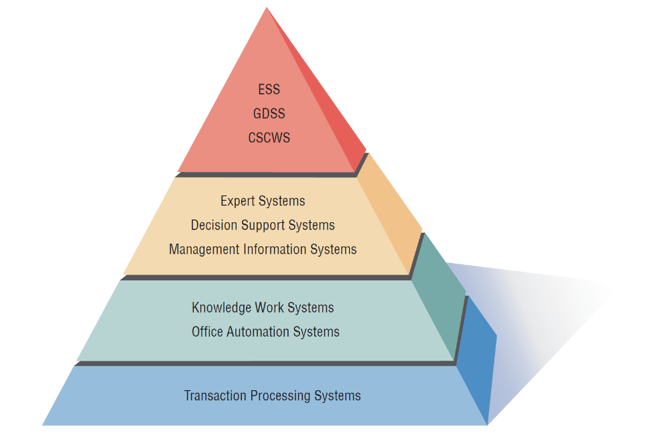
Strategic Level
A systems analyst may be involved with any or all of these systems at each organization level
Higher Level
Knowledge Level
Operational Level
Notes:
As we move from the bottom to the top, each level represents a higher level of decision support. The bottom level or organizational level supported by TPS provides very structured decision support while the top level or strategic level supported by ESS, GDSS and CSCWS provides semi-structured and unstructured decision support.

Slide 19
OPERATIONAL LEVEL
Transaction Processing System (TPS)
  Process large amounts of data for routine business transactions
  Boundary-spanning
  Support the day-to-day operations of the company
  Examples: Payroll Processing, Inventory Management
Notes:
Eliminates the tedium of necessary operational transactions and reduces the time once required to perform them manually.
TPS are boundary-spanning systems that permit the organization to interact with external environments.
It is essential to the day-to-day operations of business that Transaction processing systems function smoothly and without interruption.

Slide 20
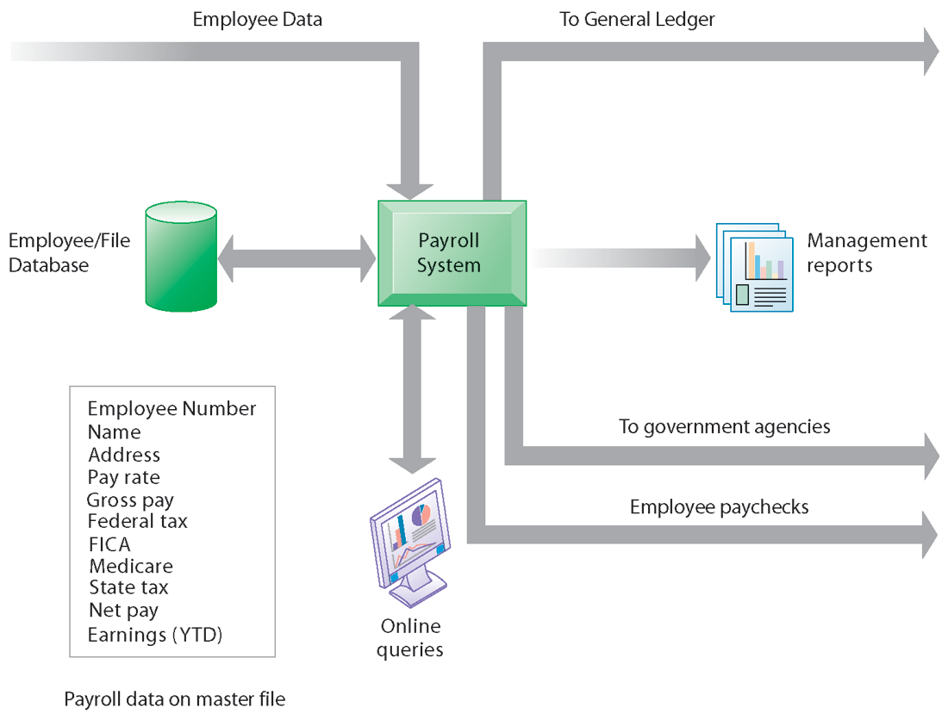
OPERATIONAL LEVEL
A Payroll TPS
A TPS for payroll processing captures employee payment transaction data (such as a time card).
System outputs include online and hard-copy reports for management and employee paychecks.
Notes:
Note that the outputs of the payroll system are useful not only within the company to managers, but also to regulatory agencies and other entities relying on the accuracy of the reported data.

Slide 21
KNOWLEDGE LEVEL
Office Automation System (OAS)
  Supports data workers who share information, but do not usually create new knowledge
  Examples: Word processing, Spreadsheets, Desktop publishing, Electronic scheduling, Communication through voice mail, Email, Video conferencing
Knowledge Work System (KWS)
  Supports professional workers such as scientists, engineers, and doctors
  Examples: computer-aided design systems, virtual reality systems, investment workstations
Notes:
OAS – support data workers, who do not usually create new knowledge but rather analyze information so as to transform data or manipulate it in some way before sharing it with, or formally disseminating it throughout, the organization and, sometimes beyond.
KWS – support professional workers such as scientists, engineers, and doctors by aiding them in their efforts to create new knowledge and by allowing them to contribute it to the organization or to society at large.
(CAD) Computer Aided Design - Automates creation, revision of products, and services
Virtual Reality - Interactive software creates simulations of real world activities
Investment workstations - Special work station to access and manipulate massive amounts of financial data

Slide 22
HIGHER LEVEL
Management Information System (MIS)
  Support a broad spectrum of organizational tasks including decision analysis and decision making
  Examples: profit margin by sales region, expenses vs. budgets
Decision Support System (DSS)
  Aids decision makers in the making of decisions
  Examples: financial planning with what-if analysis, budgeting with modeling
Expert System (ES)
  Captures and uses the knowledge of an expert for solving a particular problem which leads to a conclusion or recommendation
  Examples: MYCIN, XCON
Notes:
MIS – Support management functions of organization. Transaction processing systems are a subset of management information systems. MIS includes a wider spectrum which includes decision analysis and decision making.
Management information systems use a database which contains both data and models that help the user interpret and apply the data. The product produced by Management information systems is that used in decision making.
DSS – Much like an MIS except that it emphasizes the support of decision making in all its phases, although the actual decision is still left up to the decision maker. Closely tailored to the person or group using them.
ES – Uses the approaches of AI reasoning to solve the problems put to them by business and other users. These systems select the best solution to a problem or a specific class of problems.
Expert systems consist of:
knowledge base
inference engine – connects the user with the system by processing requests
user interface

Slide 23
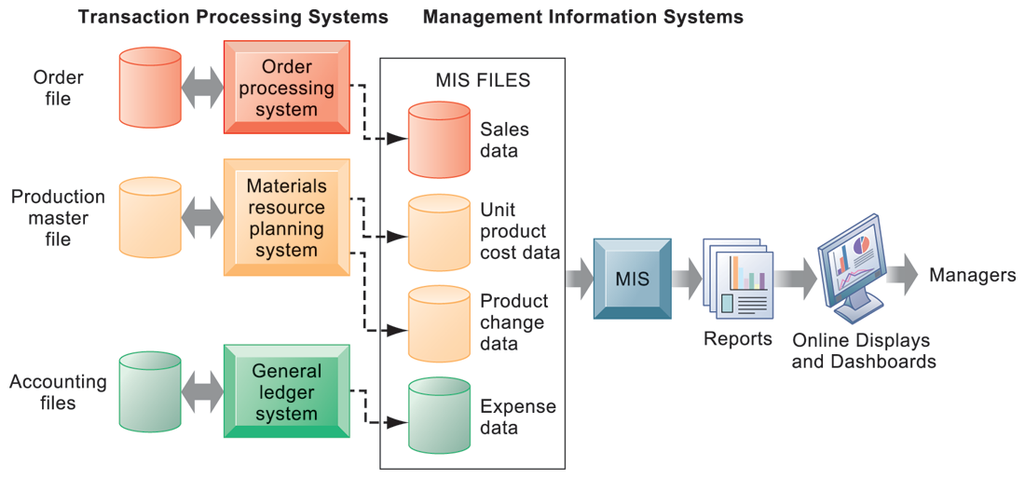
HIGHER LEVEL
Management Information System (MIS)

Slide 24
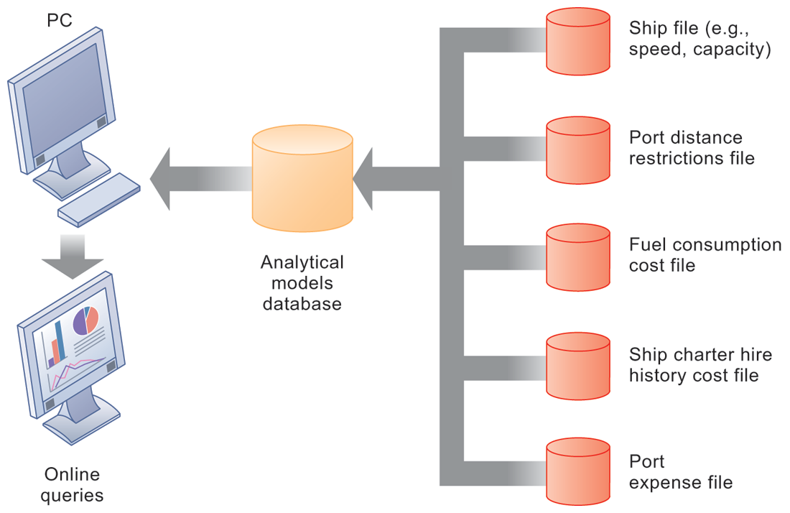
HIGHER LEVEL
Decision Support System (DSS)

Slide 25
STRATEGIC LEVEL
Executive Support System (ESS)
  Helps executives to make unstructured strategic decisions in an informed way
  Examples: drill-down analysis, status access
Group Decision Support System (GDSS)
  Permit group members to interact with electronic support
  Examples: email, Google Doc
Computer-Supported Collaborative Work System (CSCWS)
  CDCWS is a more general term of GDSS
  May include software support called “groupware” for team collaboration via network computers
  Example: video conferencing, Web survey system
Notes:
ESS – Help executives to make decisions at the strategic level by providing graphics and communication support technologies in accessible places. They help executives address unstructured decision problems by creating an environment which helps them think about strategic problems in an informed way.
GDSS – aids in group collaboration permitting group members to interact with electronic support such as polling, questionnaires, brainstorming, and scenario creation. Can be used to minimize negative group behaviors – lack of participation, domination by vocal group members, and “group think” decision making.
CSCWS – This is the more general term for group decision support systems.

Slide 26
INTEGRATING NEW TECHNOLOGIES INTO TRADITIONAL SYSTEMS
Ecommerce and Web Systems
Enterprise Resource Planning Systems
Wireless Systems
Open Source Software
Need for Systems Analysis and Design
Notes:
As new technologies are adopted they will need to be integrated with traditional systems. Systems analyst will be using these new technologies in helping people work to integrate ecommerce applications into traditional businesses or as they begin entirely new ebusinesses.

Slide 27
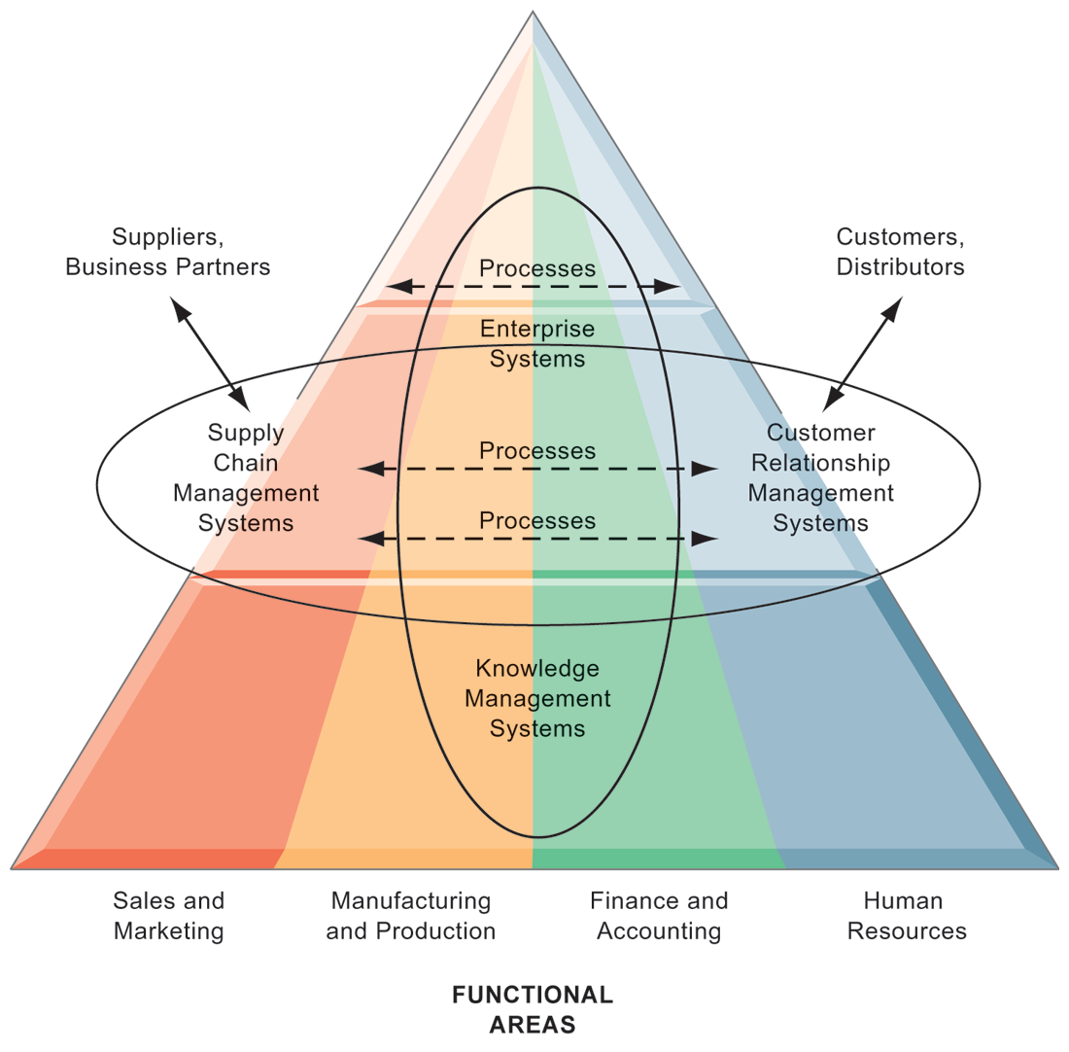
ENTERPRISE APPLICATION ARCHITECTURE
Enterprise applications automate processes that span multiple business functions and organizational levels and may extend outside the organization.
Notes:
The purpose of this graphic is simply to illustrate that enterprise systems are very large and diverse databases that pull information from many parts of the firm and enable processes both across the firm, at different organizational levels, as well as with suppliers and customers.
The triangle represents the organization, with different colors for the four main business functions. The ovals show that an enterprise application architecture incorporates systems used in sales and marketing, enabling these to communicate with each other and externally, with suppliers and customers. It also incorporates information supplied by knowledge management systems, manufacturing and finance systems, and other enterprise systems. The purpose of incorporating data and information from all of these sources is to enable and automate cross-functional business processes and supply accurate information to aid decision making.

Slide 28
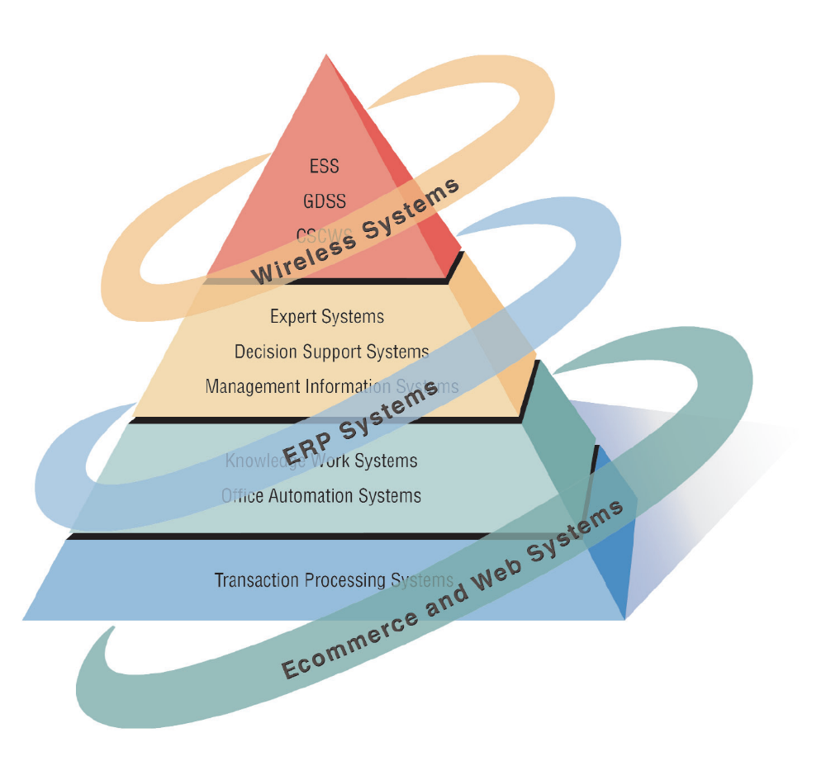
Systems analysts need to be aware that integrating technologies affects all types of systems.
ENTERPRISE APPLICATION ARCHITECTURE

Slide 29
E-COMMERCE AND WEB SYSTEMS
Increasing user awareness of the availability of a service, product, industry, person, or group
The possibility of 24-hour access for users
Improving the usefulness and usability of interface design
Creating a system that can extend globally rather than remain local, thus reaching people in remote locations without worry of the time zone in which they are located
BENEFITS
Notes:
The systems covered can have much greater functionality if they are migrated to the World Wide Web or if they are originally conceived and implemented as Web-based technologies.

Slide 30
ENTERPRISE RESOURCE PLANNING SYSTEMS (ERP)
Performs integration of many information systems existing on different management levels and within different functions
Example: SAP, Oracle
Notes:
Instituting ERP requires enormous commitment and organizational change.
Generally systems analysts server as consultants to ERP endeavors that use proprietary software.
To properly design, install, maintain, update, and use a ERP package, analysts as well as some users require vendor training, support, and maintenance.

Slide 31
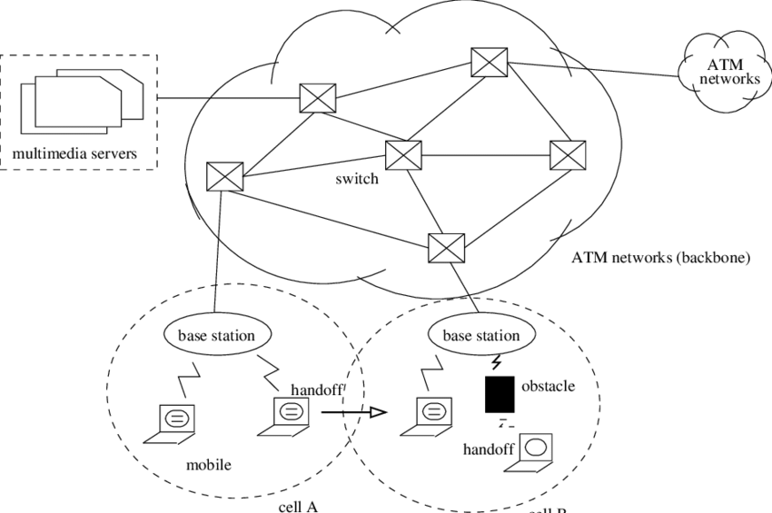
WIRELESS SYSTEMS
System analyst may be asked to design standard or wireless communication networks that integrate voice, video and email into organizational intranets or industry extranets
System analyst may also be asked to develop intelligent agents
Example: Microsoft's new software based on Bayesian statistics
Wireless communication is referred as m-commerce (mobile commerce)
Notes:
Analysts are being called to design a plethora of new systems and applications.
May be asked to develop under the standard called Bluetooth.
Intelligent agents are software that can assist users with tasks in which the software learns preferences from of users over time and then acts on those preferences.
Microsoft is developing software based on Bayesian statistics and decision making theory in combination with monitoring a user’s behavior concerning the handling of incoming information. Referred to as notification manager software that also places a dollar value on each piece of incoming information.

Slide 32

OPEN SOURCE SOFTWARE
An alternative of traditional software development where proprietary code is hidden from the users
Open source software is free to distribute, share and modify
Characterized as a philosophy rather than simply the process of creating new software
Example: Linux Operating System, Apache Web Server, Mozilla Firefox Web browser
Notes:
A movement to create, distribute, share and modify software which is not proprietary.
It’s not a monolithic movement instead it has been categorized into four community types:
Ad hoc
Standardized
Organized
Commercial
The four communities in turn differ from each other on six key dimensions:
General structure
Environment
Goals
Methods
User community
Licensing

Slide 33
PART 2
System analyst role
SDLC

Slide 34
NEED FOR SYSTEM ANALYSIS AND DESIGN
Installing a system without proper planning leads to great user dissatisfaction and frequently causes the system to fall into disuse
Lends structure to the analysis and design of information systems
A series of processes systematically undertaken to improve a business through the use of computerized information systems
Notes:
User involvement throughout the systems project is critical to the successful development of computerized information systems.
New technologies are also driving the need for systems analysis. Ajax and Ruby on Rails are two examples.

Slide 35
SYSTEM ANALYST
ENVIRONMENT
System analyst (SA) studies the problems and needs of an organization to determine how people, data, process, communications and information technology can best accomplish improvements for the business (organizations)
ROLES
The analyst must be able to work with people of all descriptions and be experienced in working with computers
Three primary roles:
QUALITIES
Problem solver
Communicator
Strong personal and professional ethics
Self-disciplined and self-motivated
Consultant
Supporting Expert
Agent of change

Slide 36
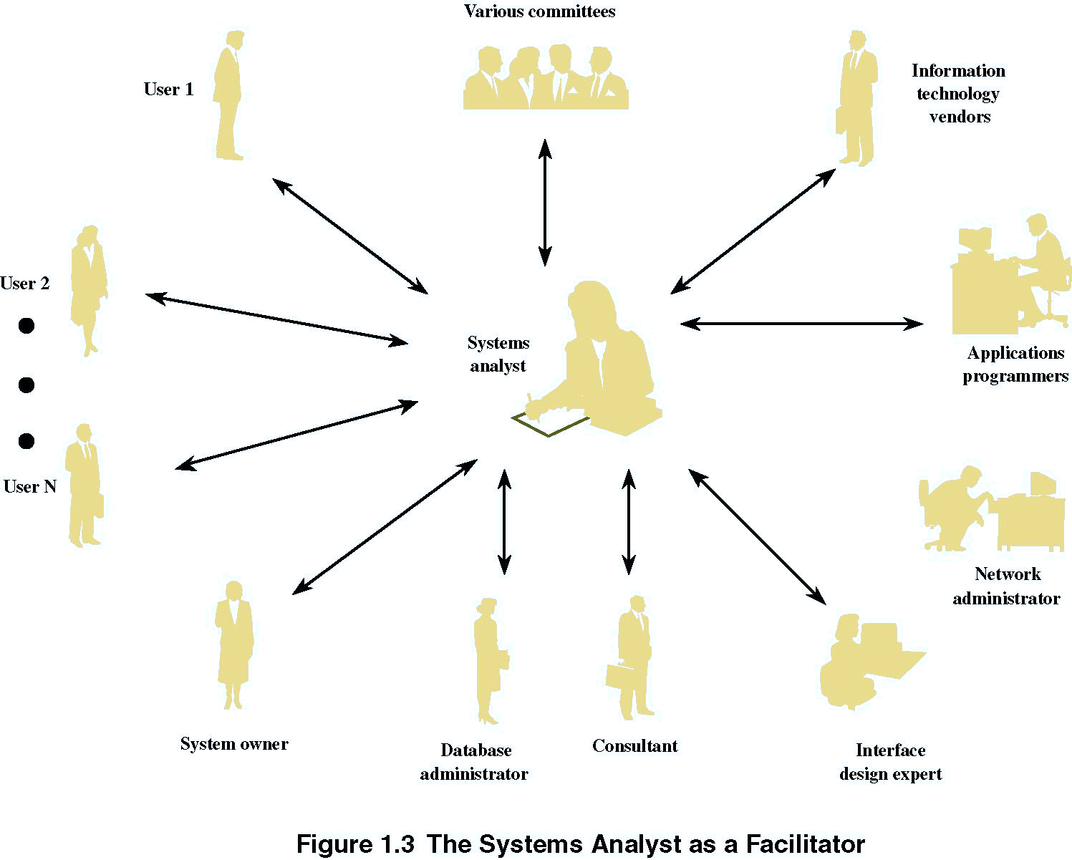
SYSTEM ANALYST

Slide 37
SYSTEM DEVELOPMENT LIFE CYCLE (SDLC)

Slide 38
SYSTEM DEVELOPMENT LIFE CYCLE (SDLC)
The systems development life cycle is a phased approach to solving business problems
Developed through the use of a specific cycle of analyst and user activities
Each phase has unique user activities.
Incorporating Human-Computer Interaction (HCI) Considerations
  The demand for analysts who are capable of incorporating HCI into the systems development process keeps increasing, as companies begin to realize that the quality of systems and the quality of work life can be improved by taking a human-centered approach at the outset of a project
Notes:
Analysts disagree on exactly how many phases there are in the SDLC.
Each phase consists of activities which overlap into other phases and then taper off, rather then done in separate steps.

Slide 39
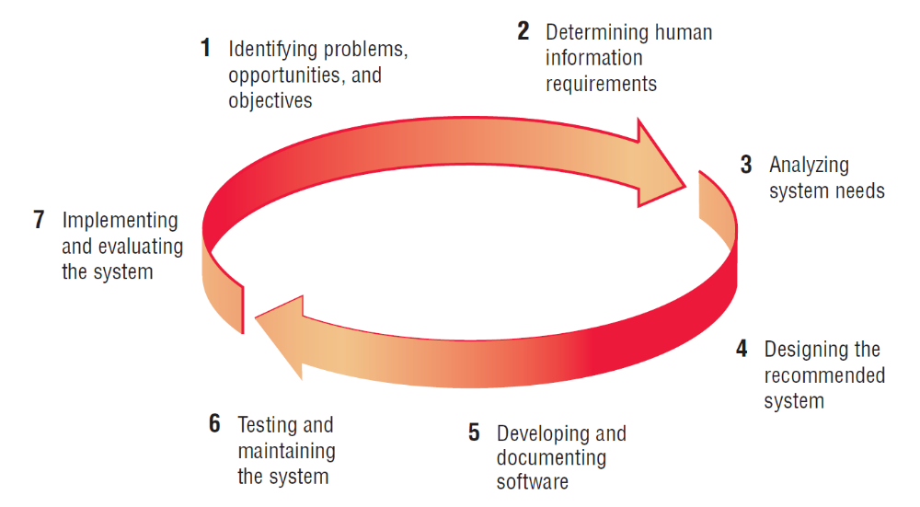
SDLC – THE SEVEN PHASES

Slide 40
PHASE 1: Identifying Problems, Opportunities & Objectives
ACTIVITY:
Interviewing user management
Summarizing the knowledge obtained
Estimating the scope of the project
Documenting the results
OUTPUT: FEASIBILITY REPORT
containing problem definition and objective summaries from which management can make a decision on whether to proceed with the proposed project (come out with your system proposal)
Notes:
Critical to the success of the rest of the project, because no one wants to waste time addressing the wrong problem.
Problems – generally the reason the analyst was called in in the first place.
Opportunities – situations that the analyst believes can be improved through the use of computerized information systems.
Objectives – how can the business reach its objectives by addressing specific problems or opportunities.

Slide 41
PHASE 2: Determining Human Information Requirements
Activity:
Interviewing
Sampling and investing hard data
Questionnaires
Observe the decision maker’s behavior and environment
Prototyping
Learn the who, what, where, when, how, and why of the current system
Output:
Analyst understands how users accomplish their work when interacting with a computer; and begin to know how to make the new system more useful and usable.
The analyst should also know the BUSINESS FUNCTIONS and have complete information on the people, goals, data and procedure involved.
Notes:
Determining human needs of the users involved.
Uses activities to pose and answer questions concerning human-computer interaction:
What are the users strengths and limitations?
Trying to understand what information users need to perform their jobs.
Who – the people who are involved
What – the business activity
Where – the environment in which the work takes place
When – the timing
How – how the current procedures are performed
Why – why the system uses the current system

Slide 42
PHASE 3: Analyzing System Needs
Activity:
Create data flow diagrams
Complete the data dictionary
Analyze the structured decisions made
Prepare and present the system proposal
Output:
Recommendation on what, if anything, should be done
Notes:
Data Flow Diagrams – chart the input, processes, and output of the business’s functions in a structured graphical form.
Data dictionary – lists all the data items used in the system, as well as their specifications.
Structured decisions made – those for which the conditions, condition alternatives, actions, and action rules can be determined.
Structure decision methods:
structures English
decision tables
decision trees
System proposal – summarizes what has been found
about users
usability and usefulness of current system
provides cost/benefit analysis of alternatives
makes recommendations on what (if anything) should be done
The recommendation or solution is based on the analysts individual qualities and professional training and their interaction with users.

Slide 43
PHASE 4: Designing the Recommended System
Activity:
Design procedures for data entry
Design the human-computer interface
Design system controls
Design files and/or database
Design backup procedures
Output
Model of the actual system
Notes:
Uses the information collected earlier to accomplish the logical design of the information system:
designs procedures for users to help them accurately enter data
provides for users to complete effective input to the information system
devises the human-computer interface
designs files or databases that will store the data needed by decision makers
designs output (onscreen or printed)
designs controls and backup procedures

Slide 44
PHASE 5: Developing and Documenting Software
Activity:
System analyst works with programmers to develop any original software
Works with users to develop effective documentation
Programmers design, code, and remove syntactical errors from computer programs
Document software with help files, procedure manuals, and Web sites with Frequently Asked Questions
Output:
Computer programs
System documentation
Notes:
The analyst uses structure charts and pseudocode to communicate to the programmer what needs to be programmed.
Documentation includes:
procedure manuals
online help
Web sites
“Read Me” files
Because users are involved from the beginning, the documentation should address the questions they have raised and solved jointly with the analyst.

Slide 45
PHASE 6: Testing & Maintaining the System
Activity:
Test the information system
System maintenance
Maintenance documentation
Output:
Problems (if any)
Updated programs
Documentation
Notes:
Testing should take place first with sample data and then with actual data.
Testing is done by both the programmers and the analyst
The maintenance started here is carried out routinely through the life of the system.
updates may be performed via a vendor site on the Web.

Slide 46
PHASE 7: Implementing & Evaluating the System
Activity:
Do user training
Analyze the plan to make sure smooth conversion from old system to new system
Review and evaluate system
Output:
Trained personnel
Installed system
Notes:
Training users to handle the system.
System conversion – converting files from old formats to new ones, or building a database, installing equipment, and bringing the new system into production.
Actually evaluation takes place during every phase.

Slide 47
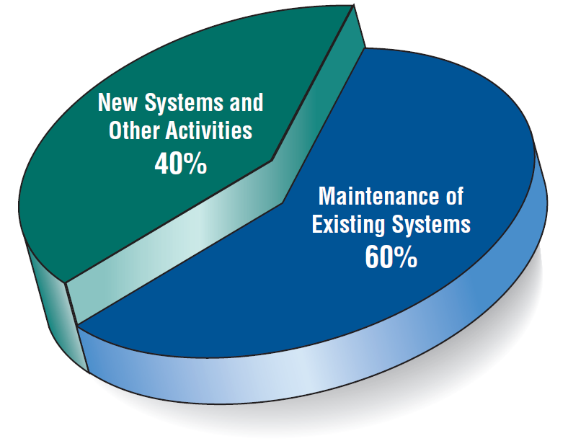
Figure 1.4 Some researchers estimate that the amount of time spent on systems maintenance may be as much as 60 percent of the total time spent on systems projects
SYSTEM MAINTENANCE

Slide 48

THE IMPACT OF MAINTENANCE
Maintenance is performed for TWO reasons:
  Removing software errors, and
  Enhancing existing software
Over time the cost of continued maintenance will be greater than that of creating an entirely new system. At that point it becomes more feasible to perform a new systems study
Notes:
Computer programs must be modified and kept up to date.
Reasons for enhancing existing software –
users request additional features
business changes over time
hardware and software change

Slide 49
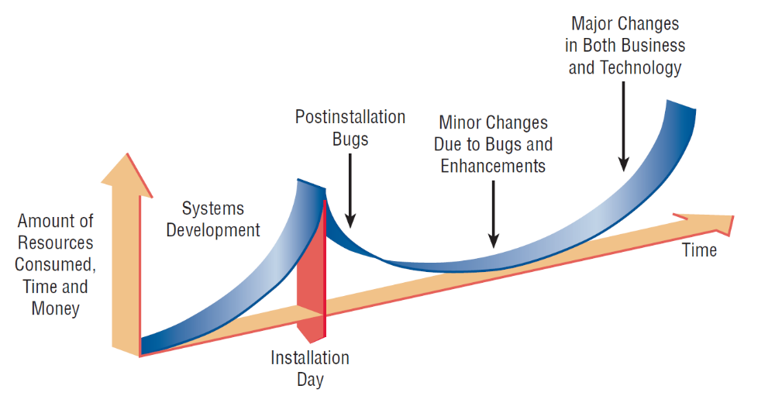
RESOURCE CONSUMPTION OVER THE SYSTEM LIFE
Notes:
Area under the curve represents the total dollar amount.
Eventually maintenance exceeds the cost of a creating a new system. At that point a new systems study should be untaken.

Slide 50
PART 3
Types, trend and approach towards developing information system
Summary

Slide 51
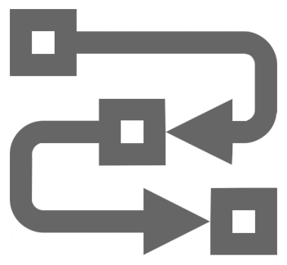

IS DEVELOPMENT METHODOLOGIES
Comprehensive guidelines to follow for completing every activity in the systems development life cycle, including specific models, tools and techniques

Slide 52
IS DEVELOPMENT METHODOLOGIES
PROCESS-ORIENTED
STRADIS Methodology - Gane & Sarson’s Methodology
Yourdon System Method (YSM)
Jackson System Development (JSD)
BLENDED
Structured System Analysis & Design Method (SSADM)
OBJECT-ORIENTED
Booch Method
OOSE
OMT
Unified Approach Methodology
Rational Unified Process
RAPID
James Martin’s RAD
Extreme Programming (XP)
Web IS development methodology (WISDM)
PEOPLE-ORIENTED
CommonKADS
ETHICS
KADS
ORGANIZATIONAL-ORIENTED
Soft-System Methodology (SSM)
IS work and Analysis of Changes (ISAC)
Process Innovation (PI)
Project in controlled environments (PRINCE)
FRAMEWORK
Multiview
Strategic options development and analysis (SODA)
Capability Maturity Model (CMM)

Slide 53
Traditional Systems Development Life Cycle (discussed in previous Part 2)
Object-Oriented Systems Analysis and Design
CASE Systems Development Life Cycle
SDLC APPROACHES

Slide 54
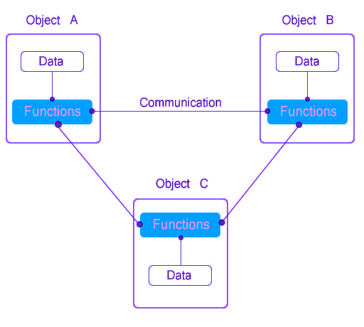
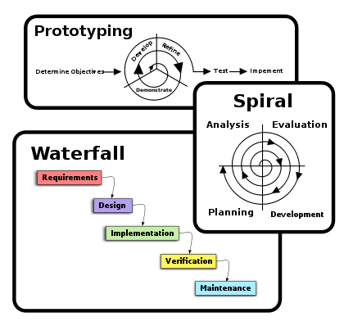
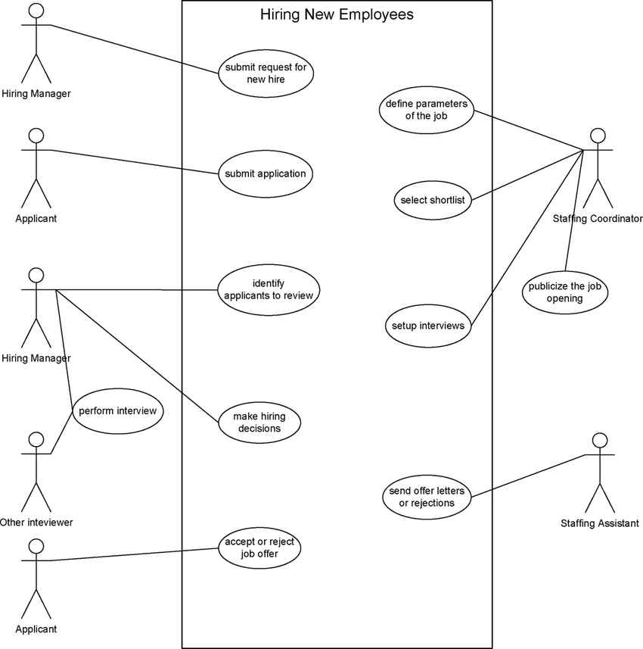
2 GENERAL APPROACHES
Traditional Approach
Object-Oriented Approach
Structured Approach
All system developers should be familiar with two very general approaches (STRUCTURED & OO) to system development, because they form the basis of virtually all methodologies

Slide 55
OBJECT ORIENTED SYSTEM ANALYSIS & DESIGN
Alternate approach to the structured approach of the SDLC that is intended to facilitate the development of systems that must change rapidly in response to dynamic business environments
Analysis is performed on a small part of the system followed by design and implementation. The cycle repeats with analysis, design and implementation of the next part and this repeats until the project is complete
Notes:
Generally works well in situations where complicated information systems are undergoing continuous maintenance, adaptation, and redesign.

Slide 56
STRUCTURED vs OBJECT ORIENTED
Structured Methodologies
O-Oriented Methodologies
STRADIS
SSADM
JSD
YSM
More…
Booch
OMT
OOSE
Unified Approach
Rational Unified Process
More…

Slide 57
STRUCTURED vs OBJECT ORIENTED
PROCESS 1
PROCESS 4
PROCESS 2
?????
Problem
Structured
PROCESS 3
OBJECT 1
OO
OBJECT 4
OBJECT 2
OBJECT 3

Slide 58
CASE TOOLS
CASE tools are productivity tools for systems analysts that have been created explicitly to improve their routine work through the use of automated support
Reasons for using CASE tools
  Increasing Analyst Productivity
  Improving Analyst-User Communication
  Integrating Life Cycle Activities
  Accurately Assessing Maintenance Changes
Notes:
Increasing analyst productivity –
automates the drawing and modifying of diagrams
automates the sharing of work thus reducing the time to collaborate with group members
facilitates interaction among team members by making diagramming a dynamic, interactive process.
Improving Analyst-User Communication – CASE tools foster greater, more meaningful communication among users and analysts.
Integrating Life Cycle Activities – integration of activities through the underlying use of technologies makes it easier for users to understand how all the life cycle phases are interrelated and interdependent.
Accurately Assessing Maintenance Changes – enable users to analyze and assess the impact of maintenance changes.

Slide 59
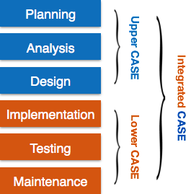
CASE TOOLS CLASSIFICATION
Upper CASE tools perform analysis and design (mainly for analyst & designers)
Lower CASE tools generate programs from CASE design (use by programmers)
Integrated CASE tools perform both upper and lower CASE functions
Notes:
Upper CASE support analyst and designers
Lower CASE support programmers and workers who must implement the systems design via Upper CASE.

Slide 60
UPPER CASE TOOLS
Create and modify the system design
Help in modeling organizational requirements and defining system boundaries
Can also support prototyping of screen and report designs
Notes:
All the information about the project is stored in the CASE repository. From the CASE repository analysis reports can be produced to show where the design is incomplete or contains errors.
The repository is a collection of records, elements, diagrams, screens, reports, and other information.
By modeling organizational requirements and defining system boundaries the analyst can visualize how the project meshes with other parts of the organization.

Slide 61
LOWER CASE TOOLS
Lower CASE tools generate computer source code from the CASE design
Source code is usually generated in several languages
Notes:
CASE code generation has several advantages:
1. Quicker than writing computer programs.
2. Time spent on maintenance decreases.
3. Code can be generated in more than one computer language.
4. Cost-effective for tailoring systems purchased from third-party vendors.
5. Generated code is free from computer program errors.

Slide 62
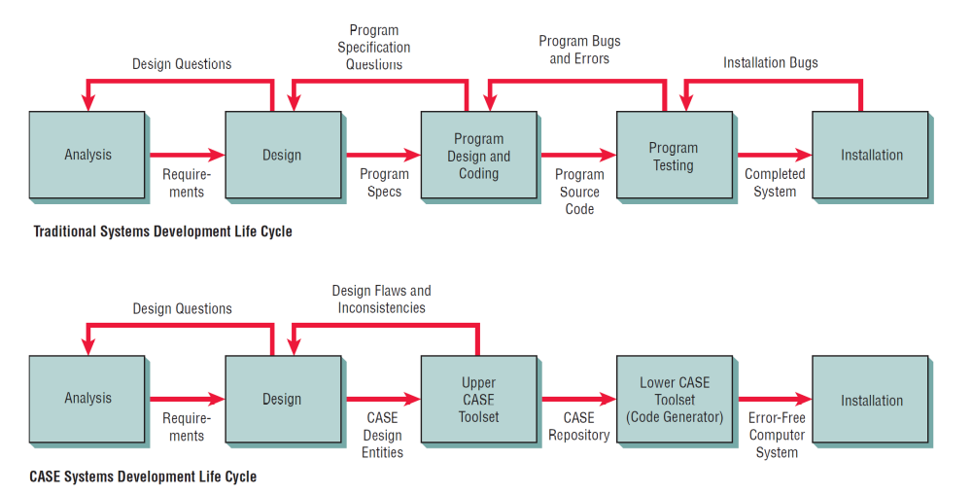
TRADITIONAL vs CASE SDLC

Slide 63
Agile approach
Prototyping
ETHICS
Project champion
Soft Systems Methodology
Multiview
ALTERNATE SDLC APPROACHES

Slide 64
MAIN COMPONENTS OF METHODOLOGY
Techniques is a collection of guidelines that help an analyst complete a system development.
METHODOLOGY
Tool is software tool that helps create models or other components required in the project
Techniques
Tools
Strategic Planning
User interviewing techniques
Data-Modeling techniques
Software-testing techniques
Project Mgt techniques
Structured analysis & design techniques
Models
CASE
Drawing/graphic applications
Reverse-engineering tool
Code generator tool
Database management application
Word processor
TECHNIQUE SAMPLES
TOOLS SAMPLES
Model is a representation of some important aspect of the real world
Flowchart
Data Flow Diagram (DFD)
Entity-Relationship Diagram (ERD)
Structure Chart
Class diagram
Sequence diagram
MODEL SAMPLES

Slide 65
Information is a key resource
Systems analysts deal with many types of information systems
Integration of traditional systems with new technologies
Roles and qualities of the systems analyst
The systems Development Life Cycle
CASE tools
Alternatives to structured analysis and design and to the SDLC
TOPIC SUMMARY

Slide 66




















SYS. ANALYSIS
Information
Gathering
Analyze
Information
Project Mgt
OVERALL PICTURE OF SYSTEM ANALYSIS & DESIGN
WFD, AD, etc
Process
Models
Logical DFD current & new system
Decision table, decision trees, etc
Data Model
SYS. PLANNING
Process Design
(Convert DFD to Str. Chart
Feasibility
Probl. Definition Report – first mile stone
Output Design
Program Design
Input Design
Database Design
SYS. DESIGN
Design spec Report 2nd milestone
SYS. IMPLEMENTATION final output (present the system)

Slide 67
REFERENCES
Kendall, K.E. & Kendall, J.E., 2014. System Analysis and Design. 9th Ed. Essex:Pearson.

Slide 68
update: August 2019 (sharinhh)

